Slide 1
Mining Massive Datasets
Wu-Jun Li
Department of Computer Science and Engineering
Shanghai Jiao Tong University
Lecture 6: Search Engines

Slide 2
Outline
Architecture of Search Engines
Index Construction
Boolean Retrieval
Vector Space Model for Ranked Retrieval

Slide 3
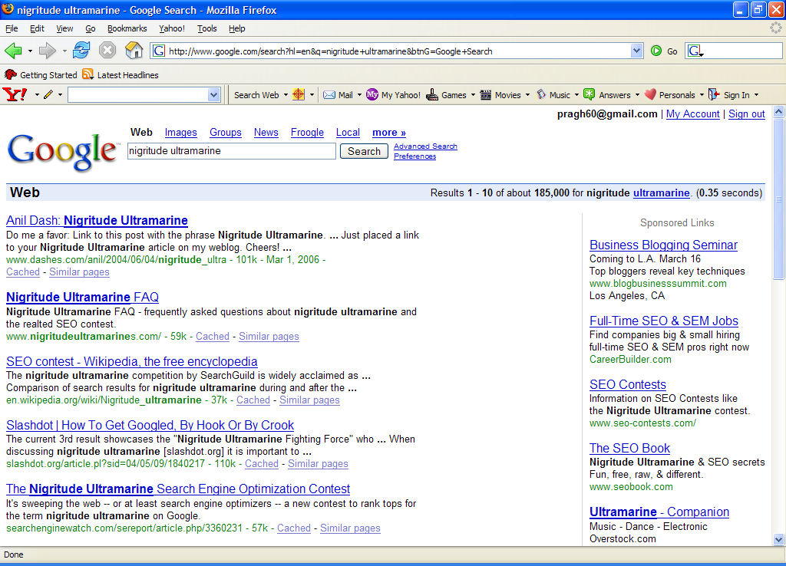
Paid
Search Ads
Algorithmic results.

Slide 4
Architecture of Search Engines (SE)
Architecture
How do search engines like Google work?

Slide 5

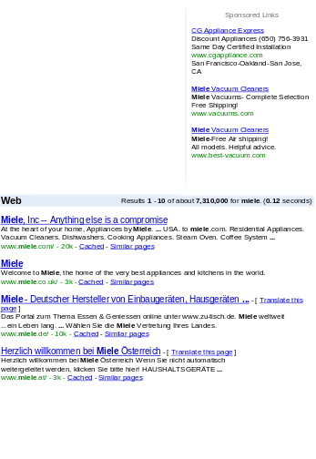

Architecture
Architecture
User
Web spider
Search
Indexer
The Web
Indexes
Ad indexes

Slide 6
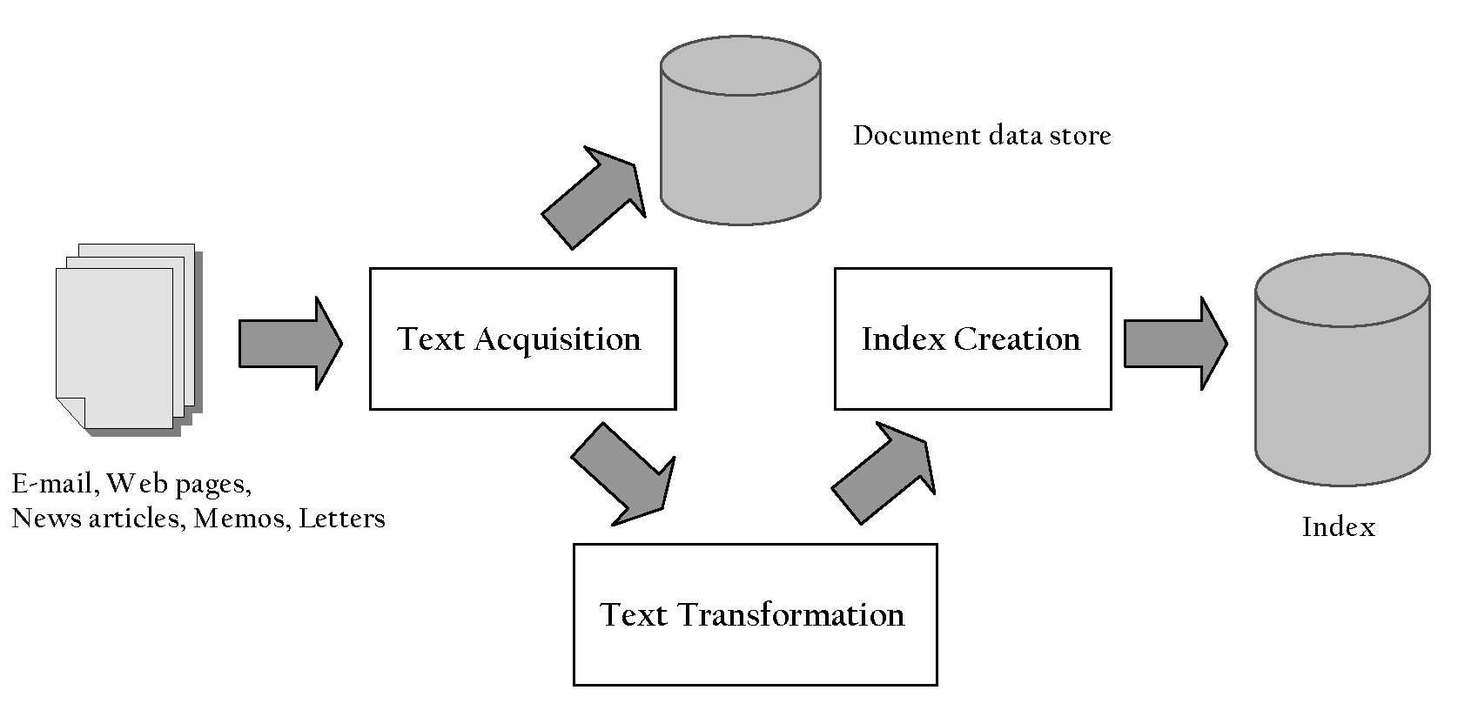
Indexing Process
Architecture

Slide 7
Indexing Process
Architecture
Text acquisition
  identifies and stores documents for indexing
Text transformation
  transforms documents into index terms
Index creation
  takes index terms and creates data structures (indexes) to support fast searching

Slide 8
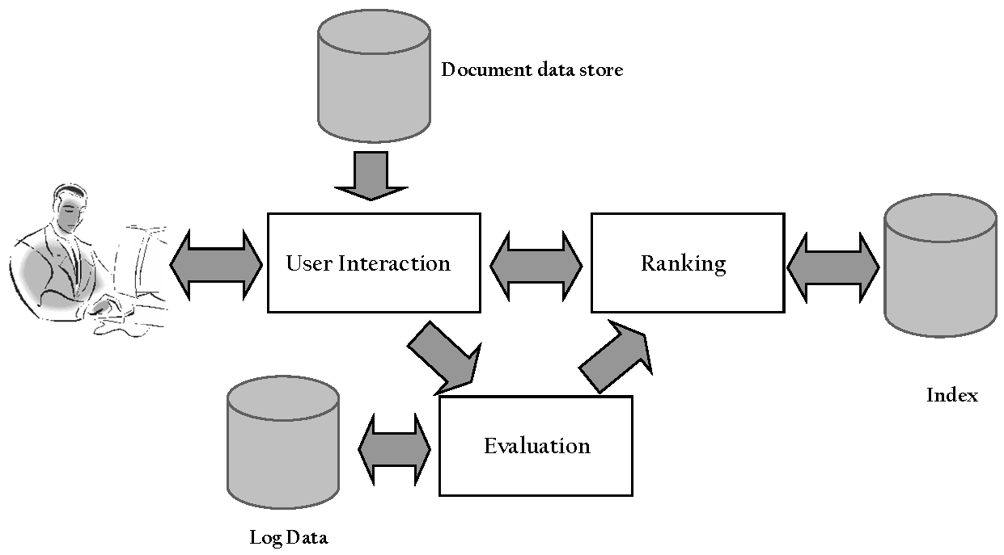
Query Process
Architecture

Slide 9
Query Process
Architecture
User interaction
  supports creation and refinement of query, display of results
Ranking
  uses query and indexes to generate ranked list of documents
Evaluation
  monitors and measures effectiveness and efficiency (primarily offline)

Slide 10
Details: Text Acquisition
Architecture
Crawler
  Identifies and acquires documents for search engine
  Many types – web, enterprise, desktop
  Web crawlers follow links to find documents
    Must efficiently find huge numbers of web pages (coverage) and keep them up-to-date (freshness)
    Single site crawlers for site search
    Topical or focused crawlers for vertical search
  Document crawlers for enterprise and desktop search
    Follow links and scan directories

Slide 11
Web Crawler
Architecture
Starts with a set of seeds, which are a set of URLs given to it as parameters
Seeds are added to a URL request queue
Crawler starts fetching pages from the request queue
Downloaded pages are parsed to find link tags that might contain other useful URLs to fetch
New URLs added to the crawler’s request queue, or frontier
Continue until no more new URLs or disk full

Slide 12
Crawling picture
Architecture
URLs crawled
and parsed
Unseen Web
Seed
pages
URLs frontier
Web

Slide 13
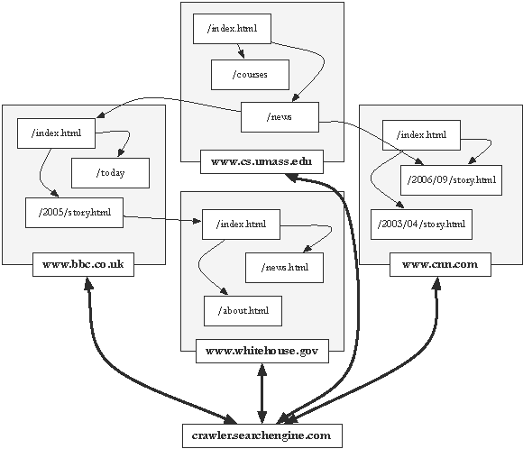
Crawling the Web
Architecture

Slide 14
Text Transformation
Architecture
Parser
  Processing the sequence of text tokens in the document to recognize structural elements
    e.g., titles, links, headings, etc.
  Tokenizer recognizes “words” in the text
    must consider issues like capitalization, hyphens, apostrophes, non-alpha characters, separators
  Markup languages such as HTML, XML often used to specify structure
    Tags used to specify document elements
      E.g., <h2> Overview </h2>
    Document parser uses syntax of markup language (or other formatting) to identify structure

Slide 15
Text Transformation
Architecture
Stopping
  Remove common words (stop words)
    e.g., “and”, “or”, “the”, “in”
  Some impact on efficiency and effectiveness
  Can be a problem for some queries
Stemming
  Group words derived from a common stem
    e.g., “computer”, “computers”, “computing”, “compute”
  Usually effective, but not for all queries
  Benefits vary for different languages

Slide 16
Text Transformation
Architecture
Link Analysis
  Makes use of links and anchor text in web pages
  Link analysis identifies popularity and community information
    e.g., PageRank
  Anchor text can significantly enhance the representation of pages pointed to by links
  Significant impact on web search
    Less importance in other applications

Slide 17
Text Transformation
Architecture
Information Extraction
  Identify classes of index terms that are important for some applications
  e.g., named entity recognizers identify classes such as people, locations, companies, dates, etc.
Classifier
  Identifies class-related metadata for documents
    i.e., assigns labels to documents
    e.g., topics, reading levels, sentiment, genre
  Use depends on application

Slide 18
Index Creation
Architecture
Document Statistics
  Gathers counts and positions of words and other features
  Used in ranking algorithm
Weighting
  Computes weights for index terms
  Used in ranking algorithm
  e.g., tf.idf weight
    Combination of term frequency in document and inverse document frequency in the collection

Slide 19
Index Creation
Architecture
Inversion
  Core of indexing process
  Converts document-term information to term-document for indexing
    Difficult for very large numbers of documents
  Format of inverted file is designed for fast query processing
    Must also handle updates
    Compression used for efficiency

Slide 20
Index Creation
Architecture
Index Distribution
  Distributes indexes across multiple computers and/or multiple sites
  Essential for fast query processing with large numbers of documents
  Many variations
    Document distribution, term distribution, replication
  P2P and distributed IR involve search across multiple sites

Slide 21
Query Process
Architecture

Slide 22
User Interaction
Architecture
Query input
  Provides interface and parser for query language
  Most web queries are very simple, other applications may use forms
  Query language used to describe more complex queries and results of query transformation
    e.g., Boolean queries, Indri and Galago query languages
    similar to SQL language used in database applications
    IR query languages also allow content and structure specifications, but focus on content

Slide 23
User Interaction
Architecture
Query transformation
  Improves initial query, both before and after initial search
  Includes text transformation techniques used for documents
  Spell checking and query suggestion provide alternatives to original query
  Query expansion and relevance feedback modify the original query with additional terms

Slide 24
User Interaction
Architecture
Results output
  Constructs the display of ranked documents for a query
  Generates snippets to show how queries match documents
  Highlights important words and passages
  Retrieves appropriate advertising in many applications
  May provide clustering and other visualization tools

Slide 25
Ranking
Architecture
Scoring
  Calculates scores for documents using a ranking algorithm
  Core component of search engine
  Basic form of score is ∑ q_{i} d_{i}
    q_{i} and d_{i} are query and document term weights for term i
  Many variations of ranking algorithms and retrieval models

Slide 26
Ranking
Architecture
Performance optimization
  Designing ranking algorithms for efficient processing
    Term-at-a time vs. document-at-a-time processing
    Safe vs. unsafe optimizations
Distribution
  Processing queries in a distributed environment
  Query broker distributes queries and assembles results
  Caching is a form of distributed searching

Slide 27
Outline
Architecture of Search Engines
Index Construction
Boolean Retrieval
Vector Space Model for Ranked Retrieval

Slide 28
Unstructured data in 1680
Index Construction
Which plays of Shakespeare contain the words Brutus AND Caesar but NOT Calpurnia?
One could grep all of Shakespeare’s plays for Brutus and Caesar, then strip out lines containing Calpurnia?
Why is that not the answer?
  Slow (for large corpora)
  NOT Calpurnia is non-trivial
  Other operations (e.g., find the word Romans near countrymen) not feasible
  Ranked retrieval (best documents to return)
Notes:
Grep is line-oriented; IR is document oriented.

Slide 29
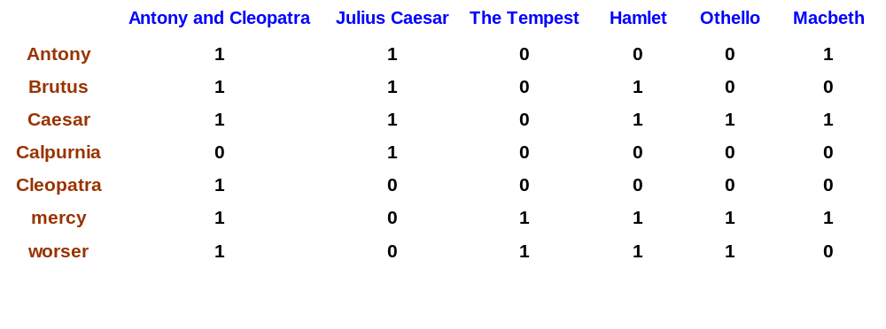
Term-document incidence
Index Construction
1 if play contains word, 0 otherwise
Brutus AND Caesar BUT NOT Calpurnia

Slide 30
Incidence vectors
Index Construction
So we have a 0/1 vector for each term.
To answer query: take the vectors for Brutus, Caesar and Calpurnia (complemented) ➔ bitwise AND.
110100 AND 110111 AND 101111 = 100100.

Slide 31
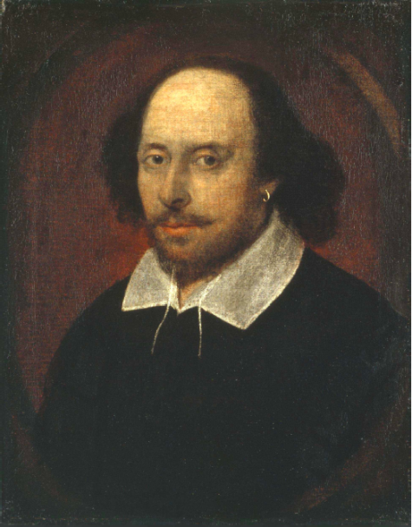
Answers to query
Index Construction
Antony and Cleopatra, Act III, Scene ii
Agrippa [Aside to DOMITIUS ENOBARBUS]: Why, Enobarbus,
When Antony found Julius Caesar dead,
He cried almost to roaring; and he wept
When at Philippi he found Brutus slain.
Hamlet, Act III, Scene ii
Lord Polonius: I did enact Julius Caesar I was killed i' the
Capitol; Brutus killed me.

Slide 32
Basic assumptions of Information Retrieval
Index Construction
Collection: Fixed set of documents
Goal: Retrieve documents with information that is relevant to the user’s information need and helps the user complete a task

Slide 33

The classic search model
Index Construction
TASK
Get rid of mice in a politically correct way
Misconception?
Info Need
Info about removing mice
without killing them
Mistranslation?
Verbal form
How do I trap mice alive?
Misformulation?
Query
mouse trap
SEARCH
ENGINE
Query
Refinement
Results
Corpus

Slide 34
Bigger collections
Index Construction
Consider N = 1 million documents, each with about 1000 words.
Avg 6 bytes/word including spaces/punctuation
  6GB of data in the documents.
Say there are M = 500K distinct terms among these.

Slide 35
Can’t build the matrix
Index Construction
500K x 1M matrix has half-a-trillion 0’s and 1’s.
But it has no more than one billion 1’s.
  matrix is extremely sparse.
What’s a better representation?
  We only record the 1 positions.
Why?

Slide 36
Inverted index
Index Construction
For each term t, we must store a list of all documents that contain t.
  Identify each by a docID, a document serial number
Can we use fixed-size arrays for this?
Brutus
1
2
4
11
31
45
173
174
Caesar
1
2
4
5
6
16
57
132
Calpurnia
2
31
54
101
What happens if the word Caesar is added to document 14?

Slide 37
Inverted index
Index Construction
We need variable-size postings lists
  On disk, a continuous run of postings is normal and best
  In memory, can use linked lists or variable length arrays
    Some tradeoffs in size/ease of insertion
Posting
Brutus
1
2
4
11
31
45
173
174
Caesar
1
2
4
5
6
16
57
132
Calpurnia
2
31
54
101
Dictionary
Postings
Sorted by docID (more later on why).
Notes:
Linked lists generally preferred to arrays
Dynamic space allocation
Insertion of terms into documents easy
Space overhead of pointers

Slide 38





Inverted index construction
Index Construction
Documents to
be indexed.
Friends, Romans, countrymen.
Tokenizer
Token stream.
Friends
Romans
Countrymen
Linguistic modules
Modified tokens.
friend
roman
countryman
Indexer
friend
2
4
roman
1
2
Inverted index.
countryman
13
16

Slide 39

Indexer steps: Token sequence
Index Construction
Sequence of (Modified token, Document ID) pairs.
Doc 1
Doc 2
I did enact Julius
Caesar I was killed
i' the Capitol;
Brutus killed me.
So let it be with
Caesar. The noble
Brutus hath told you
Caesar was ambitious

Slide 40

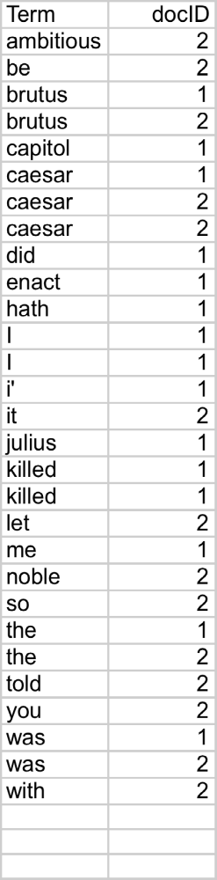
Indexer steps: Sort
Index Construction
Sort by terms
  And then docID
Core indexing step

Slide 41

Indexer steps: Dictionary & Postings
Index Construction
Multiple term entries in a single document are merged.
Split into Dictionary and Postings
Doc. frequency information is added.

Slide 42
Where do we pay in storage?
Index Construction
Lists of docIDs
Terms and counts
Pointers

Slide 43
Distributed indexing
Index Construction
For web-scale indexing
  must use a distributed computing cluster
Individual machines are fault-prone
  Can unpredictably slow down or fail
How do we exploit such a pool of machines?
  MapReduce for indexing

Slide 44
Parallel tasks
Index Construction
We will use two sets of parallel tasks
  Parsers
  Inverters
Break the input document collection into splits
Each split is a subset of documents

Slide 45
Parsers
Index Construction
Master assigns a split to an idle parser machine
Parser reads a document at a time and emits (term, doc) pairs
Parser writes pairs into j partitions
Each partition is for a range of terms’ first letters
  (e.g., a-f, g-p, q-z) – here j = 3.
Now to complete the index inversion

Slide 46
Inverters
Index Construction
An inverter collects all (term,doc) pairs (= postings) for one term-partition.
Sorts and writes to postings lists

Slide 47
Data flow
Index Construction
assign
Master
assign
Postings
Parser
a-f
g-p
q-z
Inverter
a-f
Parser
a-f
g-p
q-z
Inverter
g-p
splits
Inverter
q-z
Parser
a-f
g-p
q-z
Map
phase
Reduce
phase
Segment files

Slide 48
Schema for index construction in MapReduce
Index Construction
Schema of map and reduce functions
map: input → list(k, v) reduce: (k,list(v)) → output
Instantiation of the schema for index construction
map: web collection → list(termID, docID)
reduce: (<termID1, list(docID)>, <termID2, list(docID)>, …) → (postings list1, postings list2, …)
Example for index construction
map: d2 : C died. d1 : C came, C c’ed. → (<C, d2>, <died,d2>, <C,d1>, <came,d1>, <C,d1>, <c’ed, d1>
reduce: (<C,(d2,d1,d1)>, <died,(d2)>, <came,(d1)>, <c’ed,(d1)>) → (<C,(d1:2,d2:1)>, <died,(d2:1)>, <came,(d1:1)>, <c’ed,(d1:1)>)

Slide 49
Outline
Architecture of Search Engines
Index Construction
Boolean Retrieval
Vector Space Model for Ranked Retrieval

Slide 50
Boolean Retrieval
How do we process a (Boolean) query?

Slide 51
Query processing: AND
Boolean Retrieval
Consider processing the query:
  Brutus AND Caesar
  Locate Brutus in the Dictionary;
    Retrieve its postings.
  Locate Caesar in the Dictionary;
    Retrieve its postings.
  “Merge” the two postings:
2
4
8
16
32
64
128
Brutus
1
2
3
5
8
13
21
34
Caesar

Slide 52
The merge
Boolean Retrieval
Walk through the two postings simultaneously, in time linear in the total number of postings entries
2
2
4
4
8
8
16
16
32
64
128
32
64
128
Brutus
2
8
1
Caesar
1
2
2
3
5
5
8
8
13
13
21
21
34
3
34
If the list lengths are x and y, the merge takes O(x+y)
operations.
Crucial: postings sorted by docID.

Slide 53

Intersecting two postings lists
(a “merge” algorithm)
Boolean Retrieval

Slide 54
Boolean queries: Exact match
Boolean Retrieval
The Boolean retrieval model is being able to ask a query that is a Boolean expression:
  Boolean Queries are queries using AND, OR and NOT to join query terms
    Views each document as a set of words
    Is precise: document matches condition or not.
  Perhaps the simplest model to build an IR system on
Primary commercial retrieval tool for 3 decades.
Many search systems you still use are Boolean:
  Email, library catalog, Mac OS X Spotlight

Slide 55
Example: WestLaw http://www.westlaw.com/
Boolean Retrieval
Largest commercial (paying subscribers) legal search service (started 1975; ranking added 1992)
Tens of terabytes of data; 700,000 users
Majority of users still use boolean queries
Example query:
  What is the statute of limitations in cases involving the federal tort claims act?
  LIMIT! /3 STATUTE ACTION /S FEDERAL /2 TORT /3 CLAIM
    /3 = within 3 words, /S = in same sentence

Slide 56
Example: WestLaw http://www.westlaw.com/
Boolean Retrieval
Another example query:
  Requirements for disabled people to be able to access a workplace
  disabl! /p access! /s work-site work-place (employment /3 place
Note that SPACE is disjunction, not conjunction!
Long, precise queries; proximity operators; incrementally developed; not like web search
Many professional searchers still like Boolean search
  You know exactly what you are getting
But that doesn’t mean it actually works better….

Slide 57
Outline
Architecture of Search Engines
Index Construction
Boolean Retrieval
Vector Space Model for Ranked Retrieval

Slide 58
Ranked retrieval
Ranked Retrieval
Thus far, our queries have all been Boolean.
  Documents either match or don’t.
Good for expert users with precise understanding of their needs and the collection.
  Also good for applications: Applications can easily consume 1000s of results.
Not good for the majority of users.
  Most users incapable of writing Boolean queries (or they are, but they think it’s too much work).
  Most users don’t want to wade through 1000s of results.
    This is particularly true of web search.

Slide 59
Problem with Boolean search: feast or famine
Ranked Retrieval
Boolean queries often result in either too few (=0) or too many (1000s) results.
Query 1: “standard user dlink 650” → 200,000 hits
Query 2: “standard user dlink 650 no card found”: 0 hits
It takes a lot of skill to come up with a query that produces a manageable number of hits.
  AND gives too few; OR gives too many
Notes:
Cf. our discussion of how Westlaw Boolean queries didn’t actually outperform free text querying

Slide 60
Ranked retrieval models
Ranked Retrieval
Rather than a set of documents satisfying a query expression, in ranked retrieval models, the system returns an ordering over the (top) documents in the collection with respect to a query
Free text queries: Rather than a query language of operators and expressions, the user’s query is just one or more words in a human language
In principle, there are two separate choices here, but in practice, ranked retrieval models have normally been associated with free text queries and vice versa

Slide 61
Feast or famine: not a problem in ranked retrieval
Ranked Retrieval
When a system produces a ranked result set, large result sets are not an issue
  Indeed, the size of the result set is not an issue
  We just show the top k ( ≈ 10) results
  We don’t overwhelm the user
  Premise: the ranking algorithm works

Slide 62
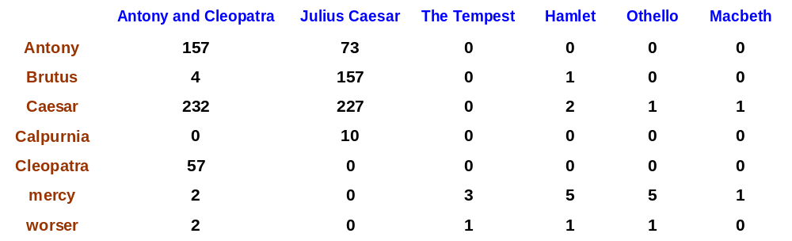
Term-document count matrices
Ranked Retrieval
Consider the number of occurrences of a term in a document:
  Each document is a count vector in ℕ^{v}: a column below

Slide 63
Bag of words model
Ranked Retrieval
Vector representation doesn’t consider the ordering of words in a document
John is quicker than Mary and Mary is quicker than John have the same vectors
This is called the bag of words model.

Slide 64
Term frequency tf
Ranked Retrieval
The term frequency tf_{t,d} of term t in document d is defined as the number of times that t occurs in d.
We want to use tf when computing query-document match scores. But how?
Raw term frequency is not what we want:
  A document with 10 occurrences of the term is more relevant than a document with 1 occurrence of the term.
  But not 10 times more relevant.
Relevance does not increase proportionally with term frequency.
NB: frequency = count in IR

Slide 65
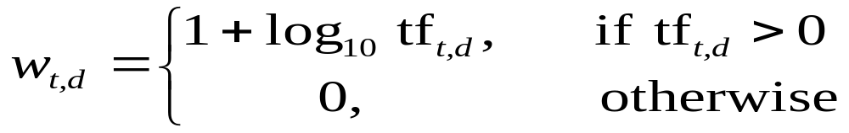

Log-frequency weighting
Ranked Retrieval
The log frequency weight of term t in d is
0 → 0, 1 → 1, 2 → 1.3, 10 → 2, 1000 → 4, etc.
Score for a document-query pair: sum over terms t in both q and d
score
The score is 0 if none of the query terms is present in the document.

Slide 66
Document frequency
Ranked Retrieval
Rare terms are more informative than frequent terms
  Recall stop words
Consider a term in the query that is rare in the collection (e.g., arachnocentric)
A document containing this term is very likely to be relevant to the query arachnocentric
→ We want a high weight for rare terms like arachnocentric.

Slide 67
Document frequency, continued
Ranked Retrieval
Frequent terms are less informative than rare terms
Consider a query term that is frequent in the collection (e.g., high, increase, line)
A document containing such a term is more likely to be relevant than a document that doesn’t
But it’s not a sure indicator of relevance.
→ For frequent terms, we want high positive weights for words like high, increase, and line
But lower weights than for rare terms.
We will use document frequency (df) to capture this.

Slide 68
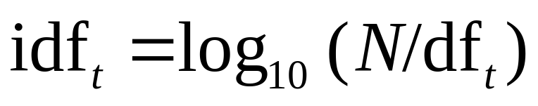
idf weight
Ranked Retrieval
df_{t} is the document frequency of t: the number of documents that contain t
  df_{t} is an inverse measure of the informativeness of t
  df_{t} ≤ N
We define the idf (inverse document frequency) of t by
  We use log (N/df_{t}) instead of N/df_{t} to “dampen” the effect of idf.
Will turn out the base of the log is immaterial.

Slide 69
idf example, suppose N = 1 million
Ranked Retrieval
term | df_{t} | idf_{t}
calpurnia | 1
animal | 100
sunday | 1,000
fly | 10,000
under | 100,000
the | 1,000,000
There is one idf value for each term t in a collection.
Notes:
6 4 3 2 1 0

Slide 70
Effect of idf on ranking
Ranked Retrieval
Does idf have an effect on ranking for one-term queries, like
  iPhone
idf has no effect on ranking one term queries
  idf affects the ranking of documents for queries with at least two terms
  For the query capricious person, idf weighting makes occurrences of capricious count for much more in the final document ranking than occurrences of person.

Slide 71
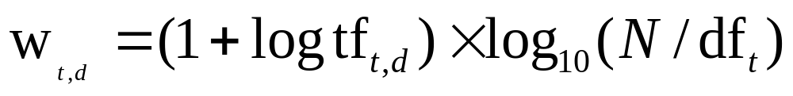
tf-idf weighting
Ranked Retrieval
The tf-idf weight of a term is the product of its tf weight and its idf weight.
Best known weighting scheme in information retrieval
  Note: the “-” in tf-idf is a hyphen, not a minus sign!
  Alternative names: tf.idf, tf x idf
Increases with the number of occurrences within a document
Increases with the rarity of the term in the collection

Slide 72
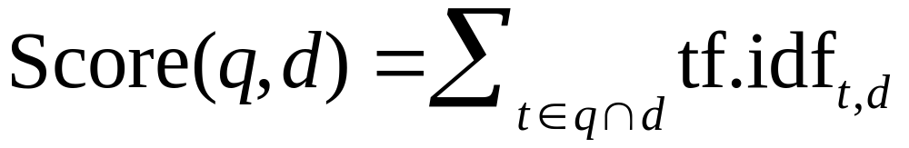
Final ranking of documents for a query
Ranked Retrieval

Slide 73

Binary → count → weight matrix
Ranked Retrieval
Each document is now represented by a real-valued vector of tf-idf weights ∈ R^{|V|}

Slide 74
Vector Space Model
---- Documents as vectors
Ranked Retrieval
So we have a |V|-dimensional vector space
Terms are axes of the space
Documents are points or vectors in this space
Very high-dimensional: tens of millions of dimensions when you apply this to a web search engine
These are very sparse vectors - most entries are zero.

Slide 75
Queries as vectors
Ranked Retrieval
Key idea 1: Do the same for queries: represent them as vectors in the space
Key idea 2: Rank documents according to their proximity to the query in this space
proximity = similarity of vectors
proximity ≈ inverse of distance
Recall: We do this because we want to get away from the you’re-either-in-or-out Boolean model.
Instead: rank more relevant documents higher than less relevant documents

Slide 76
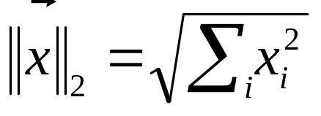
Length normalization
Vector Space Model
A vector can be (length-) normalized by dividing each of its components by its length – for this we use the L₂ norm:
Dividing a vector by its L₂ norm makes it a unit (length) vector (on surface of unit hypersphere)

Slide 77

cosine(query,document)
Vector Space Model
Dot product
Unit vectors
q_{i} is the tf-idf weight of term i in the query
d_{i} is the tf-idf weight of term i in the document
cos(q,d) is the cosine similarity of q and d … or,
equivalently, the cosine of the angle between q and d.
Notes:
See Law of Cosines (Cosine Rule) wikipedia page

Slide 78
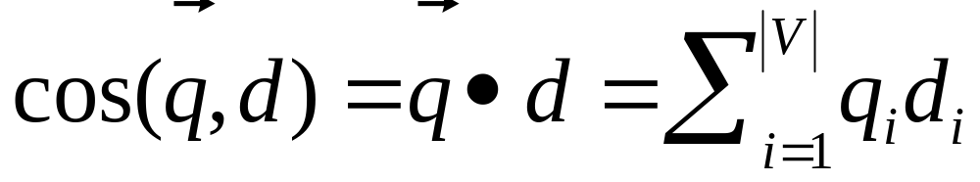
Cosine for length-normalized vectors
Vector Space Model
For length-normalized vectors, cosine similarity is simply the dot product (or scalar product):
for q, d length-normalized.

Slide 79


Cosine similarity illustrated
Vector Space Model
POOR
POOR
RICH
RICH

Slide 80
Cosine similarity amongst 3 documents
Vector Space Model
How similar are
the novels
SaS: Sense and
Sensibility
PaP: Pride and
Prejudice, and
WH: Wuthering
Heights?
term | SaS | PaP | WH
affection | 115 | 58 | 20
jealous | 10 | 7 | 11
gossip | 2 | 0 | 6
wuthering | 0 | 0 | 38
Term frequencies (counts)
Note: To simplify this example, we don’t do idf weighting.

Slide 81
3 documents example contd.
Vector Space Model
Log frequency weighting
After length normalization
term | SaS | PaP | WH
affection | 3.06 | 2.76 | 2.30
jealous | 2.00 | 1.85 | 2.04
gossip | 1.30 | 0 | 1.78
wuthering | 0 | 0 | 2.58
term | SaS | PaP | WH
affection | 0.789 | 0.832 | 0.524
jealous | 0.515 | 0.555 | 0.465
gossip | 0.335 | 0 | 0.405
wuthering | 0 | 0 | 0.588
cos(SaS,PaP) ≈
0.789 × 0.832 + 0.515 × 0.555 + 0.335 × 0.0 + 0.0 × 0.0
≈ 0.94
cos(SaS,WH) ≈ 0.79
cos(PaP,WH) ≈ 0.69

Slide 82

Computing cosine scores
Vector Space Model

Slide 83
Summary – vector space ranking
Represent the query as a weighted tf-idf vector
Represent each document as a weighted tf-idf vector
Compute the cosine similarity score for the query vector and each document vector
Rank documents with respect to the query by score
Return the top K (e.g., K = 10) to the user

Slide 84
Sources
More information at:
  http://www.cs.sjtu.edu.cn/~liwujun/course/wsm.html

Slide 85
Acknowledgement
Slides are from
  Pro. Bruce Croft
  Pro. Christopher D. Manning

